Slide 1
Code Debugging: Example Code in Python
Python code with 3 syntax errors:
Debugged code:
print("This line of code is before both IF-ELSE functions"
countervariable = 125
if (countervarable < 100):
print("Counter is smaller than 100")
print("This line is in the first if section")
else
print("Counter is greater than 100")
print("This line is in the first else section")
number = 3
if (number > 0):
print("Number is a positive number)
print("This line is in the second if section")
else:
print("Number is a negative number")
print("This line is in the second else section")
print("This line of code is after both of the IF-ELSE functions")
print("This line of code is before both IF-ELSE functions")
countervariable = 125
# Corrected variable name from 'countervarable' to 'countervariable'
if (countervariable < 100):
print("Counter is smaller than 100")
print("This line is in the first if section")
else:
print("Counter is greater than 100")
print("This line is in the first else section")
number = 3
# Corrected syntax error in the print statement (missing closing quote)
if (number > 0):
print("Number is a positive number")
print("This line is in the second if section")
else:
print("Number is a negative number")
print("This line is in the second else section")
print("This line of code is after both of the IF-ELSE functions")

Slide 2
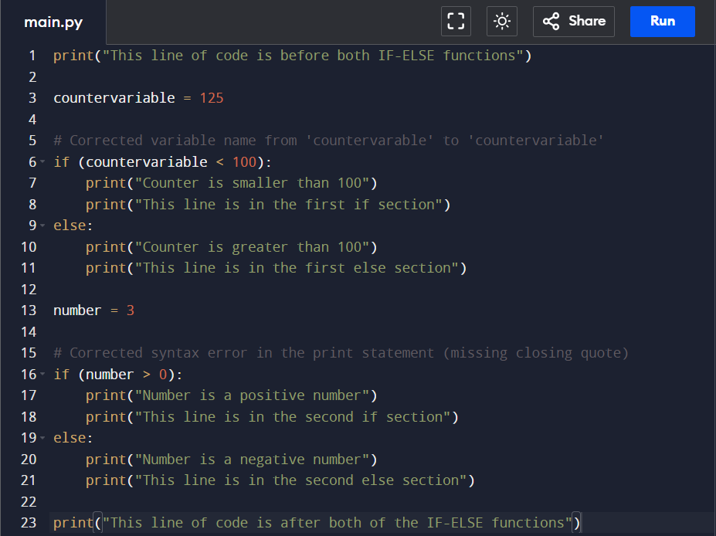
Debugged Code

Slide 3
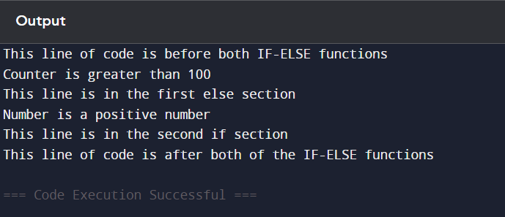
Output

